Slide 1
Solutions
Dr. Jason R. Mayberry

Slide 2
Solutions
Solution: a mixture produced when one or more substances (solids, liquids, or gasses) are dissolved in a relatively larger volume of another liquid substance.
Solvent: The liquid substance in which other substances are dissolved (usually water).
Solute: the substance that is dissolved in the solvent.
+
➔
Solute
Solvent
Solution

Slide 3
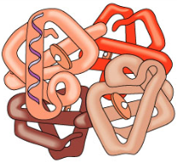
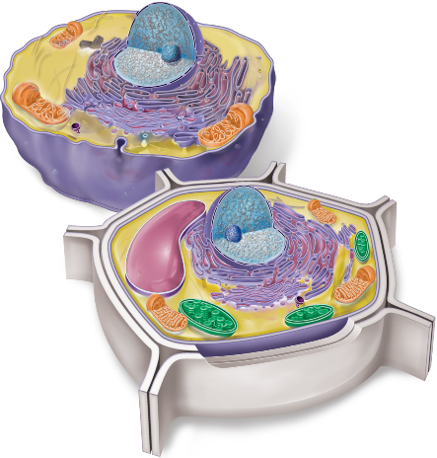
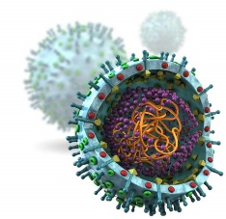
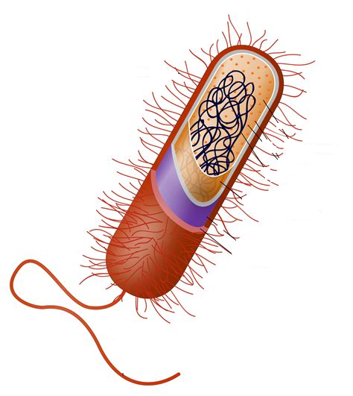
Cells are Basically Bags of Water Solutions
δ–
O
O
1
H
O
δ+
δ+
6
H
O
C
O
NH₂
+1
O
N
C
C
N
HC
A
H⁺
P
O
N
C
C
O
CH₂
–
O
N
H
11
H⁺
O–
OH
OH
Atoms and Ions
Simple Molecules
Macromolecules
Cells
Smallest part of an element that maintains the properties of that element.
Basic Building block of all ordinary matter.
Formed when a small number of atoms join together
Formed when a large number of atoms join together, often by linking simple molecules together in repetitive patterns.
Smallest living thing.
“Bags of Water”
Formed when chemistry of a self-contained system becomes self sustaining.
How would you define life?

Slide 4
Hydrophilicity vs Hydrophobicity
Hydrophilic Molecules
“Water Loving"
Will Dissolve in water
Have charges (full or partial)
Ions (e.g. NaCl, HCl)
Functional groups with large number O-H, N-H and S-H bonds relative to size of molecule
When Ionic Substances (e.g. Na+Cl-) dissolve the ions separate
When Polar-Covalent molecules dissolve, the molecules stay intact, but one molecule separates from the other.
Hydrophobic (Lipophilic) Molecules
“Water Fearing”
Will not dissolve in water
Do not have charges.
Usually made mostly of C-C and C-H bonds
Because water can dissolve so many substances it is often considered the “universal solvent” and is the medium for all biochemical reactions.
Hydrophilic Molecules
δ –
δ –
δ –
δ –
δ –
Na⁺
δ –
Cl–
δ+
δ+
δ+
δ+
δ+
δ+
δ+
δ+
δ+
δ+
δ+
δ –
δ+
Table Salt
δ –
CH₂OH
δ+
δ+
δ+
O
δ –
δ+
δ –
δ –
H
H
H
OHCH₂
OH
δ –
O
Na⁺
OH
H
Cl–
HO
H
O
HO
CH₂OH
δ+
δ+
δ+
δ+
δ+
δ+
δ+
H
δ+
OH
OH
δ –
H
δ –
δ –
Sucrose: Table Sugar
δ –
δ+
δ+
δ+
δ –
δ+
δ –
δ –
δ+
δ –
δ+
δ+
δ+
also Most Proteins
δ+
δ+
δ+
δ+
δ+
δ+
δ+
also Nucleic Acids (DNA, RNA)
δ+
Hydrophobic Molecules
δ –
δ –
O
H₂C
O
δ –
C
CH₂
CH₂
CH₂
CH₂
CH₃
δ+
δ+
δ+
δ+
O
δ –
HC
O
δ+
δ+
C
CH₂
CH₂
CH₂
CH₂
CH₃
O
δ+
δ+
δ –
H₂C
O
C
CH₂
CH₂
CH₂
CH₂
CH₃
δ –
Lipids (Fats, Oils, Waxes)
δ+
δ+
δ+
δ+
δ –
δ –
δ+
δ+
δ –
OH
Steroids (derived from cholesterol)
δ+
δ+
δ+
δ+

Slide 5
What happens when a substance dissolves?
Solutions of Ionic Compounds
NaCL dissolved in water
Na⁺
Cl–
Na⁺
Cl–
Cl–
Na⁺
Cl–
Na⁺
Ionic bonds are relatively weak and easily broken, as when dissolved in water: Ions separate from each other and are free to flow through the water.
Sodium Chloride (NaCL)
Table Salt
Solutions of Molecules with Covalent Bonds
CH₂OH
CH₂OH
Sugar dissolved in water
H
O
OHCH₂
H
O
OHCH₂
H
H
O
OH
H
H
O
OH
OH
H
OH
H
HO
H
O
HO
HO
H
O
HO
CH₂OH
CH₂OH
CH₂OH
CH₂OH
H
H
H
OH
OH
H
OH
OH
H
O
OHCH₂
H
O
OHCH₂
H
H
O
OH
H
H
O
OH
Covalent bonds are strong, and are not broken when in solution, instead intact molecules separate from other intact molecules, and are free to flow through the water.
OH
H
OH
H
HO
H
O
HO
HO
H
O
HO
CH₂OH
CH₂OH
H
H
H
OH
OH
H
OH
OH
Sugar Crystals Text color indicates different molecules of the same sugar.

Slide 6
Acids
Solutions of Ionic Compounds
NaCL dissolved in water
Na⁺
Cl–
Na⁺
Cl–
Cl–
Na⁺
Cl–
Na⁺
Ionic bonds are relatively weak and easily broken, as when dissolved in water: Ions separate from each other and are free to flow through the water.
Sodium Chloride (NaCL)
Table Salt
Solutions of Ionic Compounds – that free up H+
HCl dissolved in water
H+
Cl–
H+
Cl–
Cl–
H+
Cl–
H+
When H+ ions are added to water, it become acidic.
Hydrogen Chloride(HCL)

Slide 7
The acidity/basicity of a solution is reported relative to the concentration of H⁺
pH = negative log₁₀ of the free H⁺ concentration
[H⁺] > [OH–]
[H⁺] = [OH– ]
[OH–] >[H⁺]
H₂0
OH–
H₂0
H₂0
OH–
H₂0
H₂0
H₂0
OH–
H₂0
H⁺
OH–
H⁺
H₂0
H⁺
H⁺
H₂0
H⁺
OH–
H₂0
H⁺
H₂0
H₂0
H₂0
H₂0
H₂0
H₂0
H₂0
H₂0
H₂0
H₂0
H₂0
H₂0
H₂0
H₂0
H₂0
H₂0
H⁺
H₂0
OH–
H₂0
OH–
Acidic Solution
[H⁺] = 10⁻²M
[OH–] = 10⁻¹²M
Pure Water at 25ºC
[H⁺] = 10⁻⁷M
[OH–] = 10⁻⁷M
Basic Solution
[H⁺] = 10⁻¹²M
[OH–] = 10⁻²M
Very Acidic
Mildly Acidic
Mildly Basic
Very Basic
Neutral
pH:
2
5
7
9
12
High H⁺ Concentration
Low H⁺ Concentration

Slide 8
Acids and Bases
Acids
Molecules that tend to lose hydrogens in an aqueous environment
Bases
Molecules that tend to pick up free hydrogens in an aqueous environment
H-Cl → H⁺ + Cl⁻
H⁺ + NH3 → NH4⁺
pH = negative log of the free hydrogen ion concentration
Low pH = acidic = high H+ concentration
High pH = basic = low H+ concentration
Very Acidic
Mildly Acidic
Neutral (Pure Water)
Mildly Basic
Very Basic
2
5
7
9
12
High H⁺ Concentration
Low H⁺ Concentration

Slide 9
Why is Water Essential For Life?
Water as a Selective Solvent
Polarity of water makes it good at dissolving polar and ionic substances, but not non-polar molecules.
This behavior promotes compartmentalization, which is essential for life.
Once dissolved, ions and individual molecules are:
free to move around
more readily interact with each other
more readily undergo chemical reactions
When ions move within water, they generate electrical currents.
Each of these things is essential for life, so water’s ability to enable them make water essential for life.
δ–
N
O
H
H
δ+
δ+
S
Water is a Polar Molecule
NaCL dissolved in water
Sugar dissolved in water

Slide 10
Lab on Water and Electricity
Introduction to the Lab on Water and Electricity:
Electricity is ubiquitous in our modern society; virtually every piece of modern technology is powered by electricity: lights, television sets, cars, air conditioners, phones, computers, radios, watches, and so on and so on. Electricity is also ubiquitous to life. All cells (animal, plant, fungi, bacteria, etc) conduct electrical currents as a matter of necessity to maintain their lives. Some cells such as muscles and neurons have a highly developed ability to conduct electrical currents necessary for their specialized functions.
Generally speaking, there only a two conditions that must be met to generate an electrical current.
1) Charged particles
2) The particles must be able to flow/move freely through some medium.
When using a power source, such as a battery, to power some device, the charged particles are electrons. The electrons will only flow (condition 2 above) if there is a path (usually provided by wires) from the battery, to the item to be powered (e.g. a light bulb), and back to the battery; any break in this loop will prevent the flow of electricity.
So, how are living cells able to conduct electrical currents? As with many fundamental questions regarding life, the answer depends on the properties of water. This lab will explore the property of water that enables it to conduct electrical currents. To do this you will test a number of solid, pure liquids, and solutions for their ability to conduct an electrical current.

Slide 11
Electricity
Electrical Current
Movement of ANY charged particle
Lightening: usually electrons moving clouds ↔ ground
Batteries: electrons moving + ← – end
Cells and other bags of water: any time ions (anions or cations) exhibit net movement
Extracellular Solution
Na⁺
Na⁺
Na⁺
Na⁺
Na⁺
Na⁺
Na⁺
1.5 Volts
Na⁺
Intracellular Solution
When substances are dissolved in water, the individual particles become free to move, and therefore have the potential to generate an electrical current.

